Slide 1
SOELS ECE Workforce Committee
Welcome!
Notes:
Our second agenda item is introducing a large body of work that each hub region will be focusing on for the next several months: the Regional Assessment.
I am going to walk you through a slide deck that introduces you to what we will be doing and why.
Please feel free to ask questions as we go along.

Slide 2
ECE Workforce Recruitment
Update on Director Sessions
Tools shared
Feedback from directors
Next steps for director’s group
Notes:
Cynthia will do this report-out

Slide 3
SOELS Regional Assessment
Notes:
Our second agenda item is introducing a large body of work that each hub region will be focusing on for the next several months: the Regional Assessment.
I am going to walk you through a slide deck that introduces you to what we will be doing and why.
Please feel free to ask questions as we go along.

Slide 4
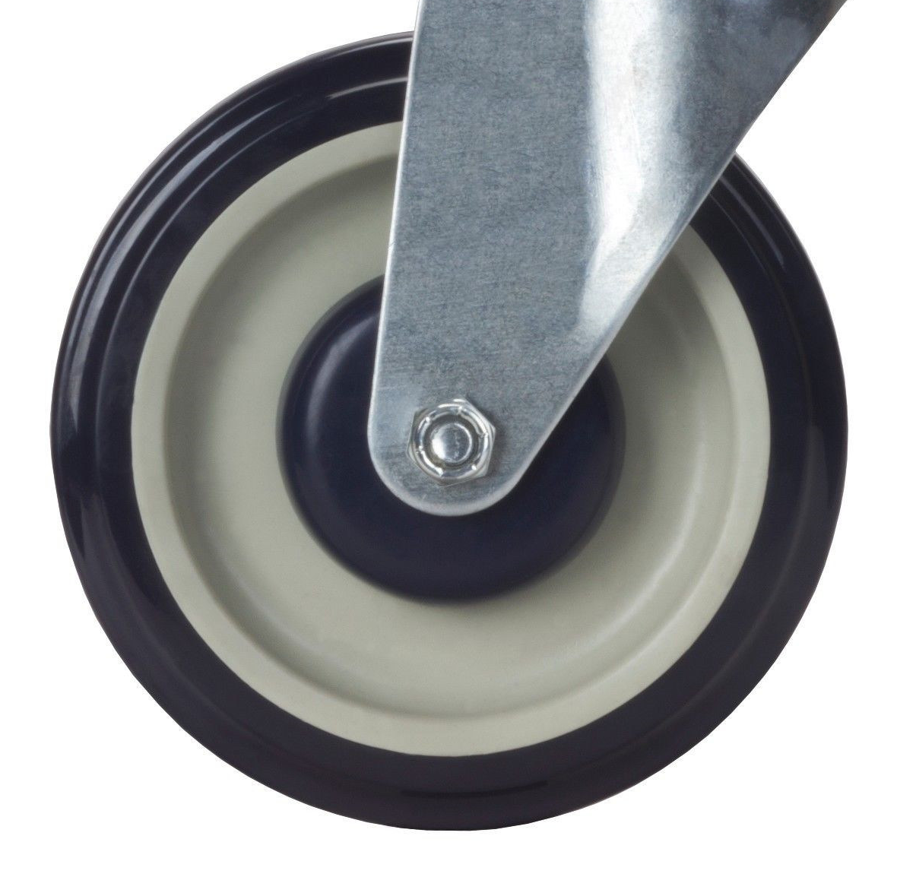
Notes:
We are starting with a story about some people who encountered a wheel for the first time. It was squeaking. Although they didn’t know much about wheels, they didn’t think it should be making such a terrible noise.
They came up with an idea, based upon some previous knowledge they had.
Put in some water, squeak went away. Job well done
Squeaking came back.
They put in more water this time, the squeaking stopped.
So THAT was the problem, just didn’t put ENOUGH water in.
But what do you think happened.
Squeaking came back. And this time they noticed something new.
Not only was it squeaking, but some rust was starting to form around the wheel barring.
Well, maybe water will help it go away. Let’s put more on.
They continued this cycle of noticing the ever worsening squeak and rust, adding more water, and noticing more of the problem until it looked like…

Slide 5
What went wrong in their problem-solving process?
Notes:
…This.
ANIMATE
What went wrong in their problem-solving process?
Didn’t understand why the wheel was squeaking, and how the wheel itself worked
As a result, their quick fix creates unintended consequences that gradually made the problem symptom worse over time

Slide 6
Children Arrive Ready for Kindergarten with Reduced Disparities
Healthy, Stable, Attached Families with Reduced Disparities
RUO Objectives
1
2
3
4
5
6
7
8
9
10
11
12
13
14
Notes:
Let’s bring this back to the Hubs.
Here are the 2 primary impacts we’re all trying to bring about:
[ANIMATE]
Children are arriving ready for kindergarten with reduced disparities in terms of race/ethnicity, income, language, geography, etc.
This means children are meeting developmental milestones in multiple domains starting prenatally until they start Kindergarten
[ANIMATE]
families are healthy, stable, and attached so they can help to support their children’s development. Here again we are trying to reduce disparities across groups
You also have 14 different RUO objectives that can enable these impacts. We can think of these as systems change objectives.

Slide 7
Children Arrive Ready for Kindergarten with Reduced Disparities
Healthy, Stable, Attached Families with Reduced Disparities
RUO Objectives
1
Regional System Assessment:
Process to understand how conditions within programs, organizations, communities, and systems
are helping and hindering regional RUO objectives and impacts
in order to design more effective strategies.
Notes:
You can think of these 14 objectives like little squeaky wheels.
ANIMATE
A Regional Assessment is a process to understand how conditions within regional programs, organizations, systems, and communities are affecting these objectives and ultimately the impacts.

Slide 8
Children Arrive Ready for Kindergarten with Reduced Disparities
Healthy, Stable, Attached Families with Reduced Disparities
1
RUO OBJECTIVE 2
Families have access to high-quality (culturally responsive, inclusive, developmentally appropriate) affordable early care and education that meets their needs.
What conditions have we discovered are affecting this squeaky wheel in our region?
Notes:
Let’s take objective 2.
Through our discussions, the workgroup thought this could be a good objective for all the hubs to assess this first year given the overlap with existing ELD deliverables. We will talk more about this in the second half of today’s agenda.
What conditions have we learned are affecting this squeaky wheel in our region?

Slide 9
Children Arrive Ready for Kindergarten with Reduced Disparities
Healthy, Stable, Attached Families with Reduced Disparities
RUO OBJECTIVE 2
1
Shared Mindsets
Goals
Decision-Making
Policies and Practices
Connections
Program Components
Human Resources
Financial Resources
Environment Resources
Watson & Collins, 2022
Foster-Fishman & Watson, 2012, 2018
Notes:
PROGRAM COMPONENTS
The array, accessibility, and quality of programs like subsidized child care. In our case, this is objective 2.
EX: Every hubs sector plans – it’s clear there are not enough ECE slots available.
HUMAN RESOURCES
How many ECE staff are in the field, and their level of skills
EX: there is an incredible shortage of ECE staff in our country that is directly impact ECE supply.
Did ANYONE see that NAEYC survey that came out last year that asked about capacity? Showed most ECE settings are under 75% of their capacity due to staffing shortage – even though there are huge waiting lists.
FINANCIAL RESOURCES
How money is allocated
EX: insufficient funding has historically been allocated to ECE at all levels of government.
ENVIRONMENTAL RESOURCES
Character and quality of the natural and built environment
EX: in some areas there is limited broadband internet availability, making it difficult for families to use online application processes.
CONNECTIONS
Exchanges and flows of information, resources, and referrals between people and organizations
EX: some subsidized ECE programs aren’t referring families on their waitlists to each other because of competition and fear of losing funding
RAISE YOUR HAND IF YOU’VE SEEN THIS DYNAMIC IN YOUR REGION
POLICIES AND PRACTICES
Formal and informal policies, practices, procedures, protocols, laws, standards, and norms
EX: Few communities have policies in place ensuring parity in wages between ECE providers and K-12 staff, even when subsidized Pre-k is placed within ECE settings.
DECISION MAKING
How decisions are made, and who is included/ excluded from these processes.
WHO IS is often excluded related to objective 2? – WRITE IN CHAT
Families and ECE workforce.
EX: Not all school districts engage ECE providers or diverse families in decision-making processes about how to structure state-subsidized 4K preschool slots.
GOALS
Stated and unstated aims, outcomes, targets, and purpose within organizations, agencies, initiatives, and systems.
EX: In a region I’m working with in WI a workforce development collaborative formally prioritized outcomes around ECE workforce which is helping to align their work with the goals of their collaborative
SHARED MINDSETS
Beliefs, values, narratives, assumptions, priorities, and attitudes that create a way of viewing reality for people who share them.
EX: Many believe child care is just babysitting instead of an opportunity to build healthy brains and improve lifelong outcomes.
This mindset makes leaders and policy makers less likely to support systematic efforts to improve child care quality.
RAISE YOUR HAND IF YOU’VE SEEN THIS DYNAMIC IN YOUR REGION

Slide 10
Notes:
Here’s another thing systems thinkers have discovered
Some of these conditions we just talked about have more power to create sustainable systems change than others.
They are like big bounders that can trigger ripples of other changes across the system.
They are often called high leverage points.
For example, changing the goals driving an organization or group can automatically trigger changes in related policies, connections, and resource allocations as these conditions start to naturally align with the new goals. That’s why goals are seen as a high system leverage point.

Slide 11
Notes:
Other conditions are less powerful to trigger wide spread systems change.
They are like little pebbles that create smaller ripple effects that aren’t as sustainable.
It’s not that these pebbles aren’t important, but they are rarely sufficient to bring about transformation
For example, some communities put on family resource fairs to give out information to families on ECE opportunities. Even though it takes a lot of time and resources to put on these events, they often don’t make a very big ripple effect. Why?
Because they only benefit families who happened to attend the event. Any families that weren’t able to attend or who move into the community after the event don’t have access to the information.
A more powerful and sustainable leverage point would be to help local organizations and businesses adopt new policies and practices of having their staff share links to current ECE information with families during natural touch points – like during prenatal appointments, home visits, or even at salons and barber shops – anywhere where current or future parents naturally go.
These policy and practice changes can have bigger and more sustainable ripple effects in the region and they take a lot less energy than putting on a resource fair every year.

Slide 12
Shared Mindsets
Goals
Decision-Making
Policies and Practices
Connections
Program and Opportunity Components
Human Resources
Financial Resources
Environment Resources
Notes:
Here’s the different leverage points that systems thinkers have discovered - from boulders to pebbles
Many group typically focus on some of these conditions within an assessment, but few explore a comprehensive array of conditions.
This can be problematic because it only allows partners to uncover part of the picture for why the wheel is squeaking but not the full picture – like learning the wheel is too tight but not discovering it’s also made out of metal.
Where do you think most collaborative groups put most of their focus?
Unfortunately, research shows most collaboratives focus on are not the most powerful
Work smarter not harder – target the right stuff to create sustainable changes
VICKI - PUT COMMON ECOSYSTEMS CONDITIONS DOCUMENT IN THE CHAT

Slide 13
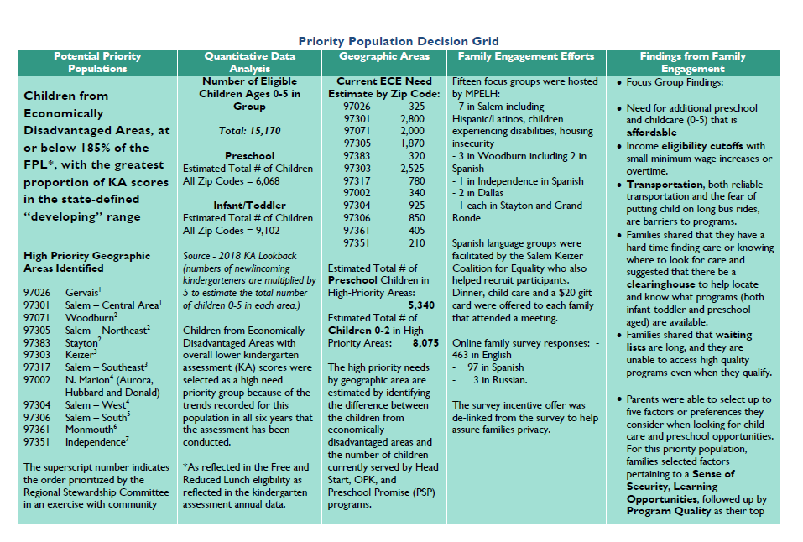
Example Assessment Questions:
What is the state of the objective in the region? To what extent are priority families being reached and getting their needs/preferences met?
What conditions are helping and hindering the objective?
Shared Mindsets
What shared beliefs are making it easier to improve the objective in this region? Which are making it more difficult?
Decision-Making
How are decisions currently made related to the objective? Who is engaged/excluded? How is this affecting our ability to improve the objective in the region?
Notes:
Drawing on the qualitative data you gather through ECE sector plan, but expanding it to be even more systemic

Slide 14
Group Discussion What are some things you hope we learn from this assessment? What might be meaningful to YOUR organization? What might be meaningful to our early learning SYSTEM?
Notes:
We are going to spend some time the benefits we would like to see come out of this work.
Feel free to just jump in or use the chat.
Your answers will help inform our assessment questions.
We want to hear from everyone, so don’t be shy!

Slide 15
Additional Benefits…
 | Build Critical Consciousness and Buy-In
 | Develop Shared Data Resources
 | Expand Engagement and Relationships
 | Generate Shared Priorities for Action
Notes:
CRITICAL CONSCIOUSNESS
Raise awareness of critical system issues
Build buy-in for strategy design process
Develop Shared Data Resources
The assessment can create a more comprehensive array of qualitative and quantitative data about regional conditions to guide decision-making and systems change strategies/actions
Can also promote integration across new and existing data sources
ENGAGEMENT
Bring new partners – including families and cross-sector organizations - into the work, deepen engagement of current partners
Generate Shared Priorities for Action
Identify shared priorities for action to guide the Hub’s strategic planning
Build partners’ understanding of what roles they can take to pursue the shared priorities
Help the group get over data analysis paralysis

Slide 16
Hubs determine assessment intensity given desired benefits and current resources
How MANY assessment questions to ask
How MUCH info to gather, and from how MANY perspectives/sources
How COMPLEX the Hub’s sense-making process will be, and WHO will be included
Notes:
The intensity will be based upon the benefits you want out of it and the resources we currently have available for this work.
Resources include:
Leveraging existing meetings
Agreements to take on tasks between meetings
Hub staff and Partners availability and skills in data analysis
Hub Staff and Partners engaging others in the work

Slide 17
Defining the Objective
RUA Obj 2: Families have access to high-quality (culturally responsive, inclusive, developmentally appropriate) affordable early care and education that meets their needs.
What does “culturally responsive, inclusive, developmentally appropriate” care look like? What evidence would you use to demonstrate it exists?
Notes:
We need to hear all perspectives on this
Jump in or put your comments in the chat for the next few slides
Vicki is collecting your responses. This defines our objective.

Slide 18
Defining the Objective
RUA Obj 2: Families have access to high-quality (culturally responsive, inclusive, developmentally appropriate) affordable early care and education that meets their needs.
What should be considered affordable – and to whom?
Notes:
We are continuing to define this objective for our region

Slide 19
Defining the Objective
RUA Obj 2: Families have access to high-quality (culturally responsive, inclusive, developmentally appropriate) affordable early care and education that meets their needs.
What types of settings should be included in the term “early care and education”? Should it include unregulated care? Why or why not?
Notes:
This is our last question related to defining our objective

Slide 20
Identifying Existing Data Sources in inform the Work
Child Care Resource Network database - # of programs, provider type, location, accepts subsidy, language, capacity, quality rating and attributes
Preschool Promise and Head Start regional data – demand, waitlist, locations, disability, language, family preferences, income data
Southern Oregon Head Start – Community Assessment: subsidized slots, demand, waitlist, location, family preferences, part vs full day, full vs part year
What else do we need to know?
What other data is currently available that can be shared with us?
Notes:
Those listed are relevant data that we have readily available.
What else do we need to know based upon our defining of the objective?
What sources would help us to learn more?

Slide 21
Next Steps
Vicki will follow up within the next week with each of you who indicated you have a data source to share
Review the handouts posted in the chat prior to next meeting
Next meeting (September):
Sara Stephens from South Coast EL Hub will present on Apprenticeship program
Committee will review available data to see WHAT WE KNOW and identify WHAT WE NEED TO KNOW based upon how we defined our objective. This will begin to generate our assessment questions.
Notes:
VICKI - PUT OVERVIEW DOCUMENT IN CHAT

