Slide 1

SOELS Governance Council
September 20, 2022

Slide 3

Preschool Promise & Coordinated Enrollment
Preschool Promise expansion and support – Cynthia
PSP Coordinated Enrollment – current efforts and challenges with expansion - Molly

Slide 4

Kindergarten Partnership & Innovation (KPI)
Early learning & kindergarten Professional Learning Teams
Student Internships in early learning programs
Kaleidoscope Play and Learn expansion

Slide 5

CCO Social Emotional Learning Metric
Changes
New Collaboration Opportunities
High level plans

Slide 6
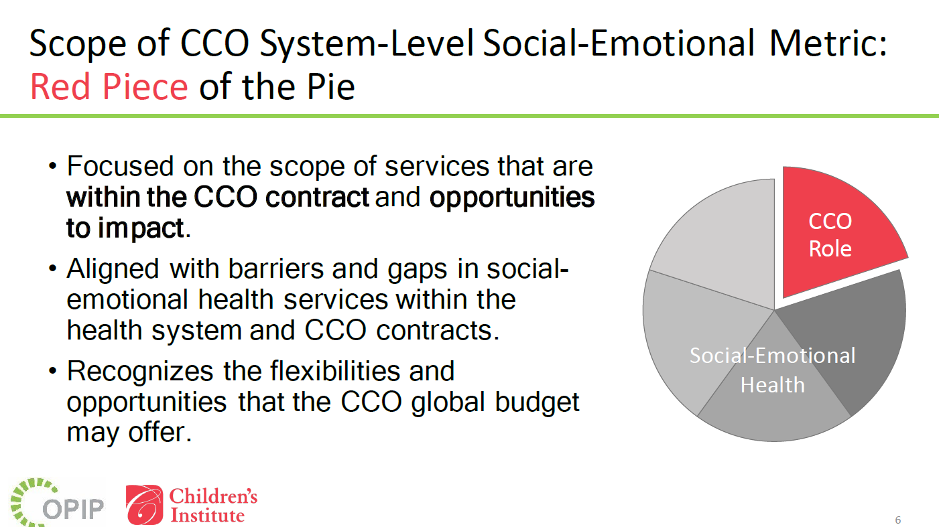

Slide 7
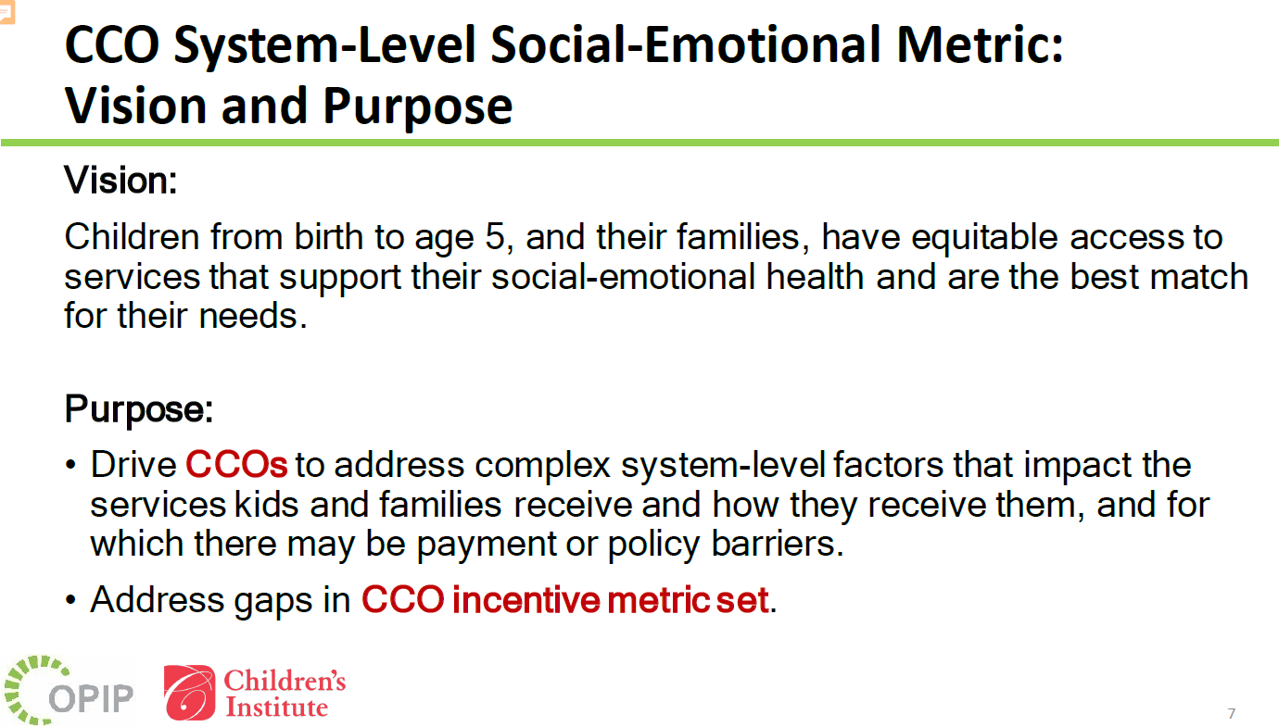

Slide 8
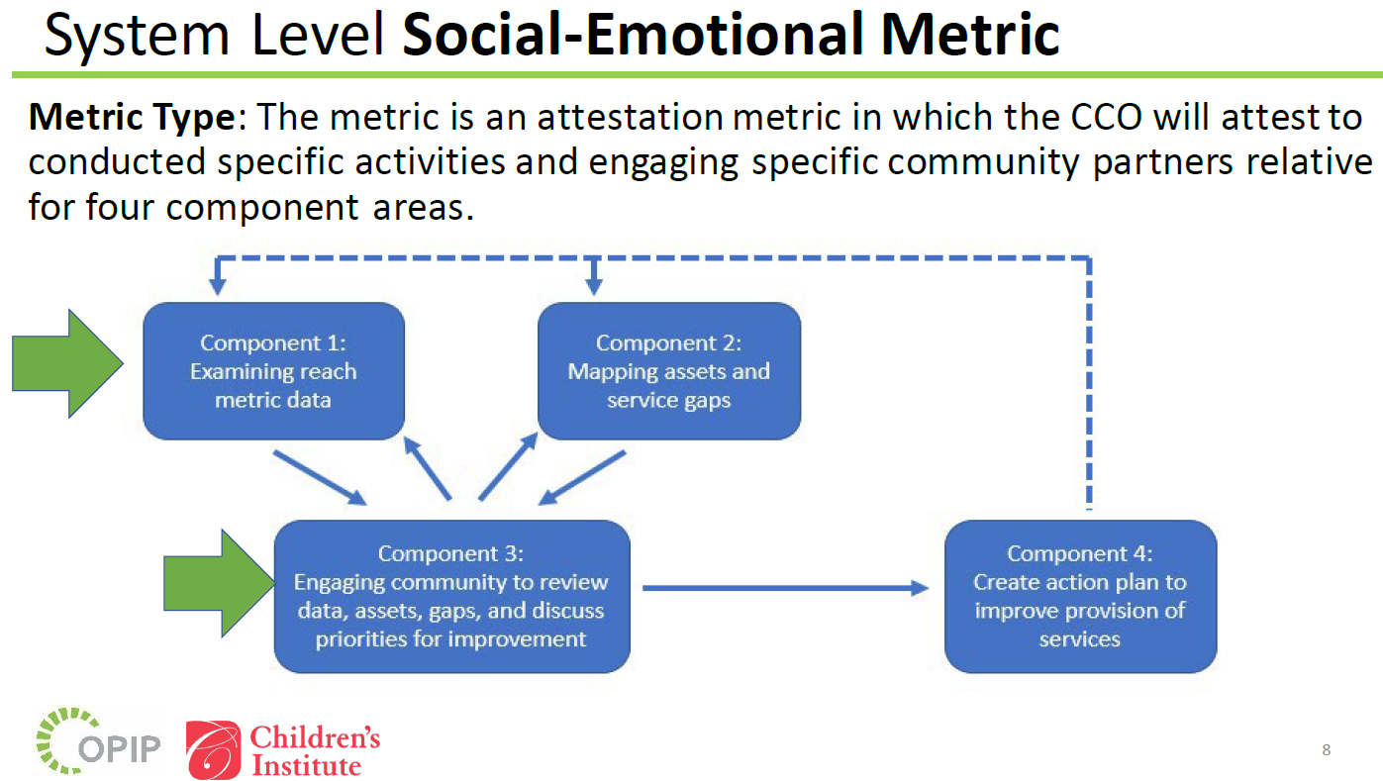

Slide 9
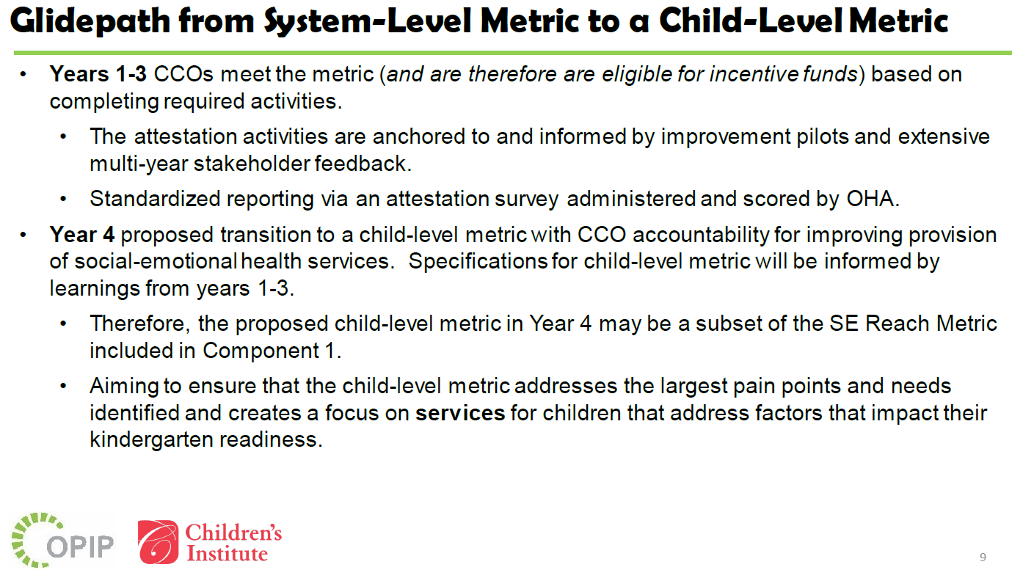

Slide 10
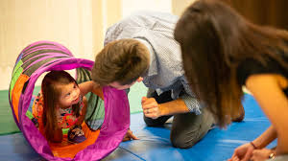
Family Engagement Focus
Family Community Centers (plural!!) - Rene
Family Leadership Council progress - Sydney
Home Visiting Partner Event - Sydney
Foster Care Partner Workgroup - Rene

Slide 11
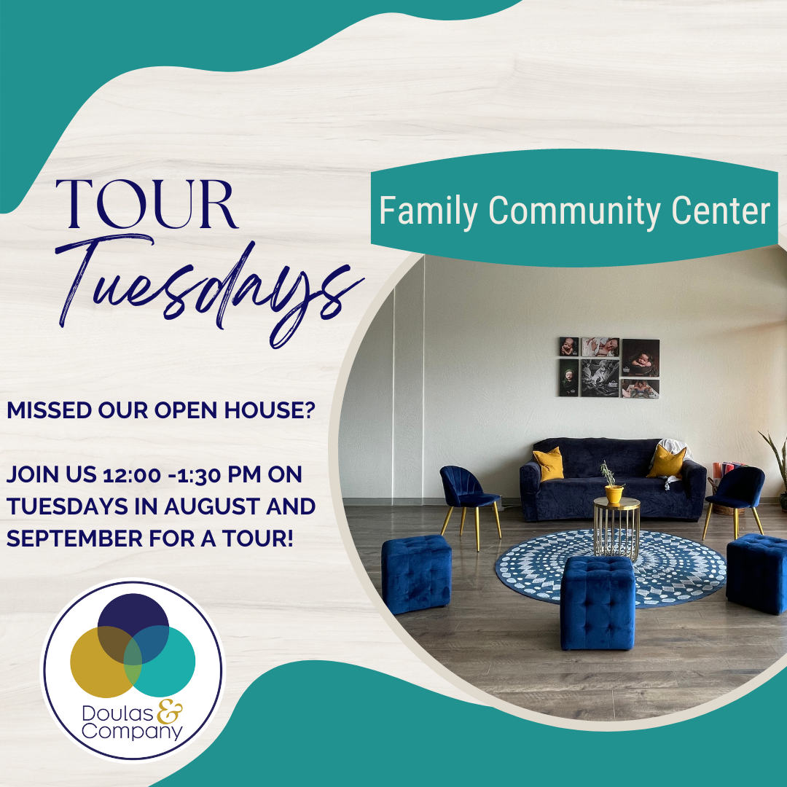
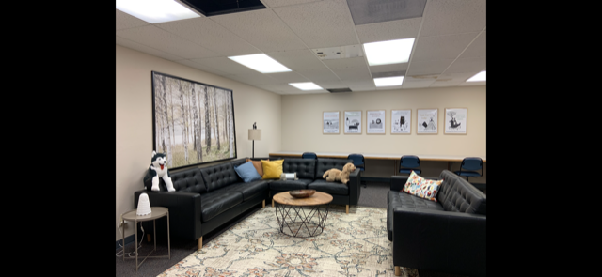
Family Community Centers
310 SW H St., Grants Pass
305 N. Bartlett St., Medford

Slide 12
Investment Priorities Review
At the start of current biennium, we reviewed and approved the investment priorities.
Focus on priority populations: Spanish speaking families, children experiencing disability, teen parents, rural communities, children without early learning prior to kindergarten, foster families, and families in recovery.
Second year of biennium, we review and course-correct, if necessary.
Report reflects services delivered through March 31, 2022
Funds do not roll over at end of biennium
  Hub Coordination is the exception – for staffing

Slide 13
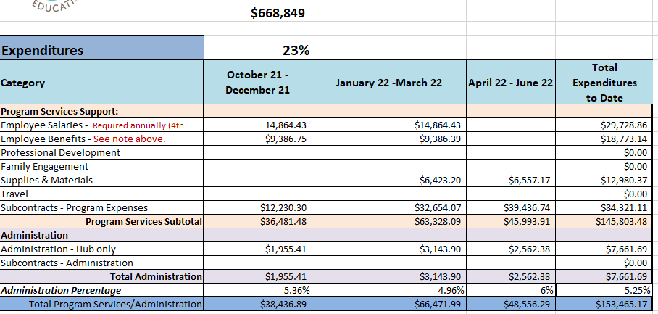
Kindergarten Partnership and Innovation (KPI)
Goals: improve early learning to kindergarten transition; shared PD, increased family engagement
  Preschool in Williams (20 children per year) $132,508
  Kaleidoscope Play and Learn Groups/Materials $175,000
  Targeted Rural Child Care Sponsorships $ 36,000
  Student Internships in Early Learning Programs $125,000
  RCC CC Provider Cohorts (English and Spanish) $100,000
  SOU Early Learning Cohort Project $ 20,000
  Early Learning & Kindergarten PLT’s $ 20,000
  SORS/SOELS EL/L Transition Summits $ 10,000
  Kinder Launch Books $ 12,000
  Strengthening Families Trainings $ 15,000
  TOTAL $645,508
  The remaining will be used for adjustment throughout the year.

Slide 14
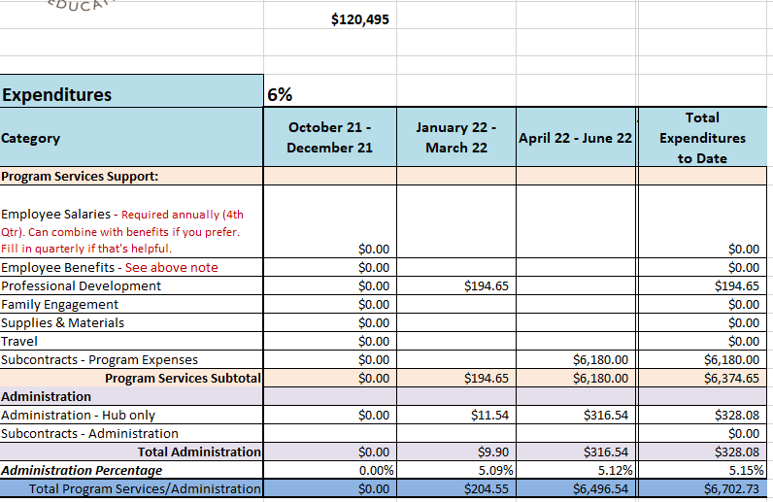
Healthy, Stable, Attached Families
Goal: Increase family stability
  Listo Family Literacy $ 50,000
  Sadie Emmons, Family Engagement $ 43,300
  Inclusion Supports for Early Learning $ 27,000
  (Tiered Model of Support)
Total $120,300

Slide 15
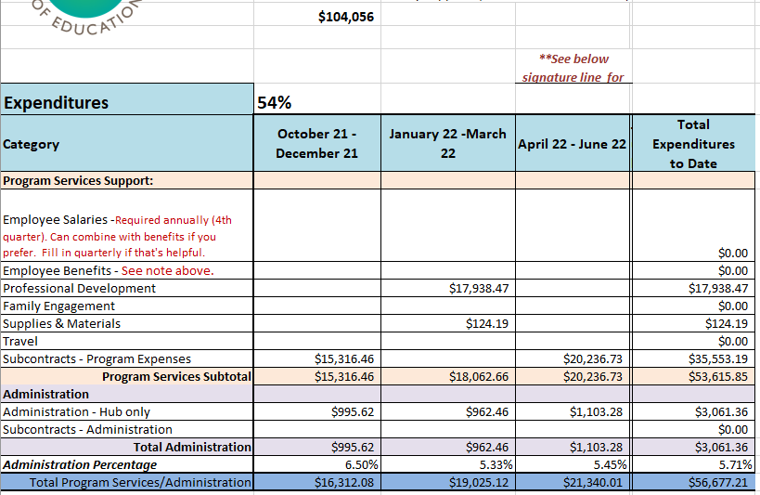
Family Support
Goal: increase family stability with investments focused on parents/caregivers rather than the child
$255,449
Young Parent Support Groups $ 63,500
  2 in Jo Co
  Target: 2 in Jackson
Foster Care Partner Workgroup $ 20,000
  Events
Sadie Emmons, Family Engagement $ 20,000
TOTAL $103,500

Slide 16
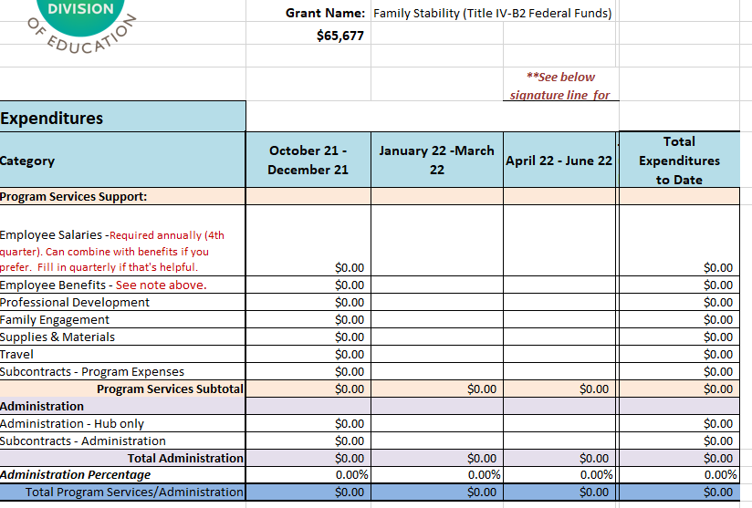
Family Preservation
Goal: increase family stability with investments focused on parents/caregivers rather than the child
$255,449
The Family Connection – Parenting Ed $14,000
Medford School District – Teen Parent Support $20,000
Respite Care/other stabilization needs TBD $31,677
Total $65,677

Slide 17
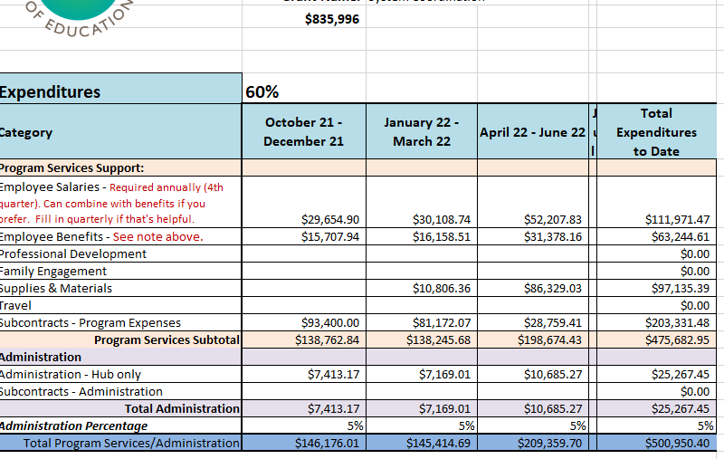
Hub Coordination
Goals: support infrastructure of hub staffing and operations; compensate parent representatives; procure consultants for hub business as needs arise
Contract with Heidi McGowan to assist with Unite Us Collaboration Work $ 4,000
Community Screening of In Utero (2) $ 1,600
SOCORAEYC Winter Conference(2) $15,000
Parent GC Representatives $ 1,000
Family Community Center in each Co. $30,000
Staffing, operations and SOESD indirect $700,000
TOTAL $751,600
The remainder is used as flexible funding when unexpected things come up - the fires, covid, etc.
$800,712

Slide 18
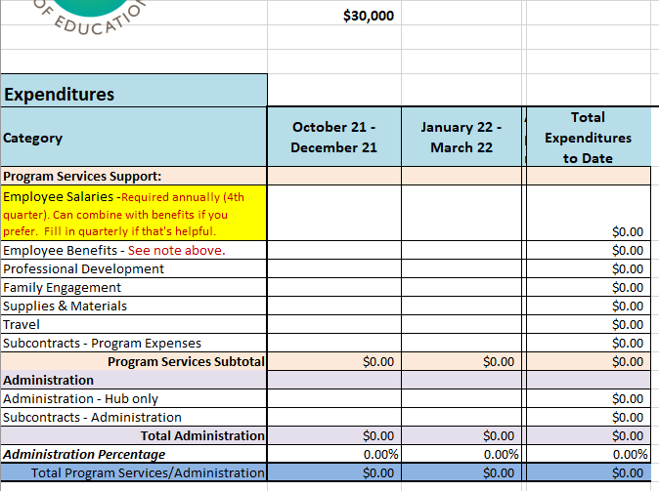
Parent Leadership Council
$30,000 must be spent by 12/31/2022
Parent Leadership Council will not be in place until Spring 2023
We are preordering materials such as hotspots, gas cards, etc. to have on hand once the Council is in place.
ELD has not yet indicated there will be ongoing funding for this council.

