Slide 1
Review Chapter 4
Beyond Strategy: Culture
The business world analogy
  Good strategies matter – plans, ways of doing things
  Culture matters more – shared values, beliefs, behaviors
  Companies with positive cultures outperformed companies with negative cultures
  Revenue, income and stock prices of companies with positive cultures were 246% - 755% above those with negative cultures
How is positive culture defined in business world?
Employee Engagement =
  Better customer engagement
  Higher productivity
  Better retention
  Fewer accidents
  Higher profitability

Slide 2
Beyond Strategy: Culture
  Without positive culture in a school, equity strategies will underperform.
  Culture and belonging must precede inclusion and engagement strategies.
  Environment = climate + culture
  Climate is “the heart and soul” of the environment – do people feel like they belong?
  Culture is “the way we do things around here” - norms, values, beliefs, traditions, and rituals that build up over time

Slide 3
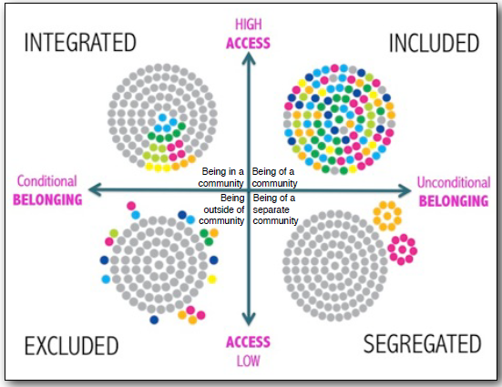
Four Diverse Environments

Slide 4
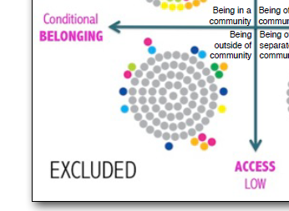
Excluded
People are outside of the culture, denied access because they are unable to meet the membership standards of belonging
Notes:
Examples of Exclusive Environments:
Exclusive schools, in ‘good’ neighborhoods, not accessible to those outside that neighborhood. Home value = property taxes that partly fund schools
Ivy League Schools
Learning tracks in K-12
Pros or Cons:
Ex: learning tracks in schools = lower expectations, less access to quality education

Slide 5
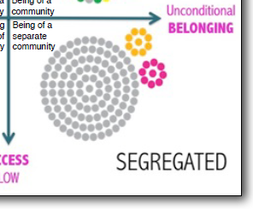
Segregated
People are in a subordinate culture, separated from the mainstream culture, where they experience a sense of belonging but disproportionately low access
Notes:
Examples:
Segregation in US schools, restaurants, everywhere
Pros/Cons:
Find unconditional belonging through membership in a marginalized community.
Provides safe space.
Desegregation policies following Brown vs. Board of Education decimated black communities. Black teachers and administrators couldn’t easily find work.
38,000 educators in 17 states were displaced for their jobs between 1954-1965
Black children no longer had teachers who looked like them, who lived in their neighborhoods. Many receiving schools/parents/educators didn’t want them. Decreased their sense of belonging.

Slide 6
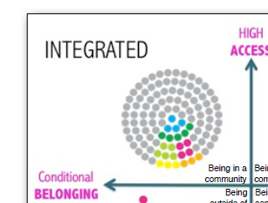
Integrated
People are in the dominant culture, having access but belonging remains conditional, based on the degree to which people are able to achieve and conform to academic and social standards of the dominant culture
Notes:
Ex: Indian schools, special education students being integrated into existing classes
Pros:
Access to more resources
Cons: does not promote sense of belonging; can create tokenism; pressure to fit in is high. They have to choose between access (so they stick it out) OR belonging (they return to their marginalized group for a safe space)

Slide 7
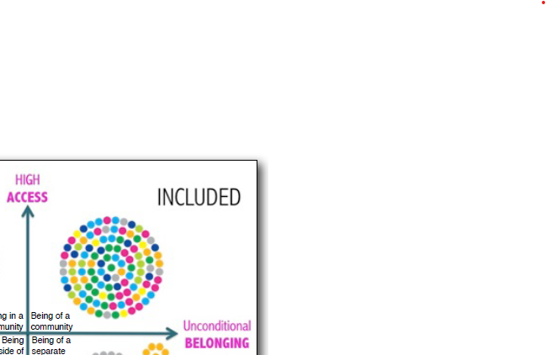
Included
People are of the culture, co-creating and experiencing access and belonging through a process of systemic and cultural transformation
Notes:
Ex:
Pros: accepted, access, belonging, safe space by design

Slide 8
American Association of Colleges and Universities (AACU) – Inclusive Excellence Scorecard
  FOUR ELEMENTS OF FOCUS
  A focus on student intellectual and social development
  A purposeful development and utilization of organizational resources to enhance student learning
  Attention to the cultural differences learners bring to the educational experience that enhance the enterprise
  A welcoming community that engages all of its diversity in service of student and organizational learning
FOUR CATEGORIES FOR SCORING
Access and Equity
Diversity in the formal and informal curriculum
Campus climate
Student learning and development
Notes:
P.86 – 89
Refer to the sample scorecard
The Chapter stresses that the culture is the strategy.
What could we move toward locally?

Slide 9
Chapter 5
Beyond Respect: Dignity
Dignity is not the same as respect.
Dignity: the innate, equal worth of each human being simply because that person is human
We are born with it but we aren’t born with an understanding of how recognize, reclaim, or extend it to others
Donna Hicks: “an internal state of peace that comes with the recognition and acceptance of the value and vulnerability of all living things”
Notes:
Dr. Donna Hicks, international affairs and conflict resolution specialist at Harvard U
Recognizing vulnerability is important: Even though we are equally valuable, we are not equally vulnerable at all times. Some are much more vulnerable to harm.
Important to note – dignity is not respect. Respect can be earned or lost due to behavior. Dignity is unconditional and everyone deserves to have their dignity honored, even when they fall short of earning respect.
The bottom line for educators: either they model dignity, or they don’t.

Slide 10
Indicators of Belonging – 4 States of Being
Appreciated - having parts of your identity admired and positively noticed and/or represented by people, media, others
Validated - having your lived experiences, thoughts, and/or feelings recognized and accepted as real, even if the other person(s) has not experienced similar things and may even disagree with the issues involved in your experience
Accepted - having your personhood completely embraced and regarded favorably without conditions attached to full belonging
Treated Fairly – having interactions defined by fairness and justice according to your specific circumstances, which may mean not being treat the same as others in order to ensure access to opportunities
Notes:
How can we know we are ‘doing’ dignity?
How can we gauge, assess and benchmark the effectiveness of our behaviors, practices, and policies?
By comparing our behaviors, practices and policies to the Indicators of Belonging.
These are the signs that a person’s dignity is being honored and that they feel like they belong.

Slide 11
How can we know if a person feels they belong?
Examples of Various Dimensions of Difference
Ability | Accent | Age | Appearance
Background | Body | Size/Shape | Class
Culture | Education | Ethnicity | Gender
Job/Title/Role | Politics | Race | Religion/Faith
Sexual Orientation | Style | Values
Notes:
In any environment, each of us will have varying experiences based upon these differences.
We have different emotional responses as well, based upon these previous and cumulative experiences.
To use the indicators of belonging effectively, we need to better understand people’s experiences with use and within our environments. These experiences involve various dimensions of differences and we need to acknowledge their emotional responses.

Slide 12
Hicks’s 10 Essential Elements of Dignity
Acceptance of Identity – support expression of people's authentic selves without judgment | Safety – put people at ease, physically and psychologically
Recognition – validate people | Independence – enable agency
Acknowledgement – respond to concerns | Understanding – listen to perspectives
Inclusion – welcome and issue invitations | Benefits of the Doubt – extend trust
Fairness – treat people with equity | Accountability – apologize for causing harm

Slide 13
Chapter 6: Recognize Distortions of Dignity
“Othering” is the problem
  Us vs. Them mentality
  Innate hostility toward the unfamiliar
  The instinct to perceive and push back against those who are different than us
  Feeling superior over those we consider inferior

Slide 14
Cultures That Honor or Violate Dignity
Culture of Dignity A foundation for equity and inclusion | Culture of Indignity A foundation for inequity and exclusion
NORMS
Presume Competence and positive intent | Presume Incompetence
Build partnerships and community | Dominate
Repair harm and restore relationships | Blame and shame
Affirm differences and uniqueness | Degrade differences

Slide 15
Cultures That Honor or Violate Dignity
Culture of Dignity A foundation for equity and inclusion | Culture of Indignity A foundation for inequity and exclusion
Experiences
Belonging | Othering
Appreciated | Otherized
Treated fairly | Mistreated
Accepted | Marginalized
Validated | Dismissed
Notes:
When we experience belonging…
When we experience othering…

Slide 16
Cultures That Honor or Violate Dignity
Culture of Dignity A foundation for equity and inclusion | Culture of Indignity A foundation for inequity and exclusion
Core Dispositions
Empathy | Apathy
Openness | Judgment
Patience | Intolerance
Listening | Denial
Notes:
The core dispositions of a culture of dignity…
The core dispositions of a culture of indignity…

Slide 17
Cultures That Honor or Violate Dignity
Culture of Dignity A foundation for equity and inclusion | Culture of Indignity A foundation for inequity and exclusion
Core Values
Inclusion: | Exclusion, Integration, Segregation:
Unconditional belonging (belong to achieve) | Conditional belonging (achieve to belong)
High access | Low access
Honoring dignity is the precursor to cultural responsiveness and any other equity methodology ever conceived –
past, present or future.
Notes:
This goes back to the matrix we looked at a little while ago:
A culture of dignity (inclusion) has unconditional belonging and high access
A culture of indignity (segregation, integration, exclusion) has conditional belonging and low access

Slide 18
We are wired to violate dignity
We are instinctively aware of our own vulnerability of human dignity
We all want to be accepted and treated as if we matter
In a perverse way, we can weaponize this human vulnerability by seeking to diminish others’ feelings of belonging
We seek to seize control so that we can feel safe rather than vulnerable
It’s a natural human failing that when we feel our own dignity is vulnerable, we can be tempted to violate the dignity of others

Slide 19
Hicks’s Temptations to Violate Elements of Dignity
Take the bait: letting the bad behavior of others determine your own for the purpose of getting even | Avoid Conflict: allowing someone to violate your dignity without speaking up for yourself
Save Face: lying to cover up or deceive others to prevent looking bad in the eyes of others | Play the Victim: claiming innocence in failed relationships
Shirk Responsibility: refusing to admit it when you have made a mistake and shifting the blame onto someone else | Resist Feedback: deflecting feedback about your blind spots that others can see and you cannot
Seek False Dignity: gaining one’s sense of self-worth from external sources instead of relying on one’s inherent self-worth | Blame or Shame Others to Deflect Your Guilt: not being able to tolerate being exposed of a wrongdoing; instead, placing blame on others
Seek False Security: remaining in a relationship in which your dignity is routinely violated | Gossip: talking about others in a negative way in order to connect with others
Notes:
We can think of examples for ourselves, in our interactions at home with family and friends, or at work with coworkers or other partners.
In my opinion, this is one of the most powerful parts of this book: we need to understand the psychology behind our own vulnerability and the instinctive self-protectiveness we have before we can actively create a sense of belonging for others.

Slide 20
Deficit Thinking
Deficit Thinking is the notion that students, particularly low income, minority students, fail in school because they have inherent inadequacies that obstruct the learning process
  Limited intelligence
  Lack of motivation
  Inadequate home socialization
Deficit Thinking grants educators permission to blame students for their poor performance within a system that sends them countless signals that they do not belong
Deficit Thinkers look outward toward the students and not inward toward their own role (and the role of the dominant culture) in these students’ experiences

Slide 21
Mitigating the Effects of Negative Stereotypes
Normalize belonging uncertainty
Routinely share personal stories
Continually affirm people
Practice perspective taking
Help people work together successfully
Extend positive greetings at the door

Slide 22
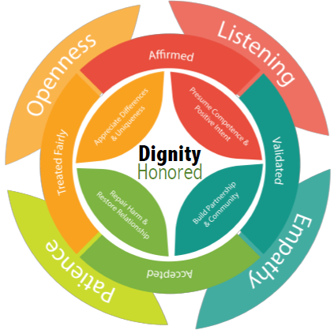
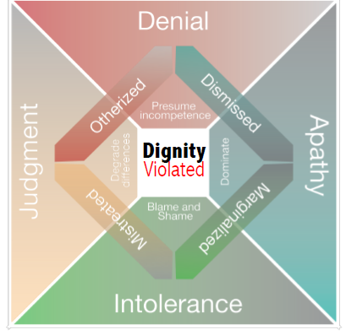
Q: How can we know if a person feels they belong?
Answer: Ask ourselves another question - Have we honored or violated their dignity?
Notes:
Dignity is the foundation - the only foundation – upon which to build schools that work for every student.
When we show up everyday OPEN, LISTENING, SHOWING EMPATHY AND PATIENCE,
Then students feel AFFIRMED, VALIDATED, ACCEPTED AND TREATED FAIRLY.
In action, this looks like:
BUILDING PARTNERSHIPS AND COMMUNITY
REPAIRING HARM AND RESTORE RELATIONSHIPS
AFFIRMING DIFFERENCES AND UNIQUENESS
PRESUMING COMPETENCE AND POSITIVE INTENT
What hinders our ability to see and honor dignity are:
The distortions of JUDGEMENT, DENIAL, APATHY, INTOLERANCE
The indicators of Othering: otherized, mistreated, dismissed, marginalized
These violate dignity because they DEGRADE DIFFERENCES, PRESUME INCOMPETENCE, BLAME AND SHAME, OR DOMINATE
The good news: honoring dignity is free. It’s a culture shift. Circling back to the beginning: the culture is the strategy.

