Slide 1
Belonging through a Culture of Dignity: Keys to Successful Equity Implementation
Chapter 7: Developing Dispositions of Dignity

Slide 2
Check In Question
Pick one of the following core dispositions that represents the biggest opportunity for your own personal growth:
Empathy
Patience
Openness
Listening
Which disposition did you choose and why?

Slide 3
The Courage to Be Uncomfortable
It takes courage to develop the personal dispositions that honor dignity: the courage to confront, challenge, and change ourselves.
The process of change should involve disequilibrium, discomfort, and struggle, followed by growth.
Nothing extraordinary happens while we remain in our comfort zone!

Slide 4
Co-create Brave Space
Brave Space is an environment within which we acknowledge the unavoidable risk, struggle, and discomfort that accompanies authentic engagement with the concepts of dignity and belonging
Requires us to confront our participation in systems of othering and humiliation
Builds on the idea of ‘safe space’ but does not promote the illusion of a risk-free environment
Rejects comfort and safety as defining elements
Elevates the notion of courage

Slide 5
Brave Space Conditions and Guidelines
Brave Space Condition | Sample Brave Space Guidelines
Empathy | Try on new perspectives. Stories shared here stay here.
Patience | Slow down to prepare to go far.
Openness | Take some risks and practice vulnerability. Keep an open mind.
Listening | Listen to understand not to respond.

Slide 6
The Dignity Journey Starts Within
We can’t honor the dignity of others until we learn to honor the dignity in ourselves
The extreme fragility of the human ego leads people to question whether or not they are ‘enough’ and most importantly, whether they are worthy to accord themselves dignity
When we can’t see dignity in ourselves, we fear to see it in others
Primitive fear gives rise to envy; We feel we must defend ourselves
We engage in actions that seek to strip dignity from others
We compare ourselves to others, magnify their flaws = false dignity
Notes:
Imposter Syndrome

Slide 7
False Dignity
Inflated sense of value
Artificial substitute for self-worth only exists relative to others’ “faults” and “lesser” status or identity
Simplest forms: petty gossip, bullying to make oneself feel superior
At its worst: the processes and conditions that cultivate group-based marginality and inequality throughout our world
  Racism
  Sexism
  Homophobia
  Anti-Semitism
  Islamophobia

Slide 8
“We don’t have time to focus on ourselves and personal growth….there’s work to do”
We can’t give what we don’t have
This truth has been shared for thousands of years:
  Namaste/Hindu Greeting – ‘the divine in me bows to the divine in you’
  Christianity – ‘love thy neighbor as thyself’
  Islamic hadith – “Take advantage of five before five:
    Your youth before your old age
    Your health before your illness
    Your riches before your poverty
    Your free time before your work
    Your life before your death”
  Mahatma Gandhi – “Be the change you wish to see in the world”

Slide 9
Dignity Violations Also Start From Within
Many of us can be insecure about showing up in professional and social settings as our authentic selves
Will we be valuable enough to others?
If we perceive we are inadequate, we can try to be someone we are not
  Violates our own dignity and the dignity of others in the process
  Violating our own dignity prevents us from recognizing dignity in others
  “I can’t even see myself, how do you expect me to see you?”

Slide 10
Cultivating Worthiness
Dignity is innate but difficult for us to see in ourselves
Dignity Distorters get in the way by distorting our self image
  Apathy
  Judgement
  Intolerance
  Denial
To engage in life with a sense of worthiness, we must let go of those distorters and embrace Dispositions of Dignity
  Empathy
  Patience
  Openness
  Listening

Slide 11
Correcting Dignity Distorters and Nurturing Dignity Dispositions
To Correct This Distorter: | Let Go Of… | Embrace… | To Nurture Dignity Disposition:
APATHY | What you are “supposed to” do | What makes you come alive | EMPATHY
 | Rationalizing in your head | Listening to your heart
 | Numbness to pain | Self-determination
 | Thinking you are alone | Feeling connected
 | Blaming Others | Owning feelings
 | Busy-ness | Reflection
 | Mindlessness | Mindfulness
 | Productivity as self-worth | Play as self-care

Slide 12
Correcting Dignity Distorters and Nurturing Dignity Dispositions
To Correct This Distorter: | Let Go Of… | Embrace… | To Nurture Dignity Disposition:
JUDGMENT | The need to control | Trust | OPENNESS
 | Perfectionism | Self-compassion
 | What people think | Authenticity
 | Comparison | Creativity
 | Guilt and shame | Forgiveness
 | Fear of the unknown | Adventure
 | Being cool, watching from the sidelines | Singing, laughing, and dancing like nobody’s watching
 | Feedback triggers | Feedback is a gift

Slide 13
Correcting Dignity Distorters and Nurturing Dignity Dispositions
To Correct This Distorter: | Let Go Of… | Embrace… | To Nurture Dignity Disposition:
INTOLERANCE | The need for immediacy | The beauty of the journey | PATIENCE
 | Need for certainty | Faith
 | Anxiety as a normalized lifestyle | Stillness and calmness
 | Scarcity mindset | Gratitude Attitude
 | Productivity as self-worth | Rest and relaxation as self-care

Slide 14
Correcting Dignity Distorters and Nurturing Dignity Dispositions
To Correct This Distorter: | Let Go Of… | Embrace… | To Nurture Dignity Disposition:
DENIAL | Self-doubt | Self-affirmations | LISTENING
 | Past regrets | Creating future
 | Noise | Silent reflection
 | Distractions | Focus
 | Needing to be understood | Seeking to understand
 | The need to be right | Self-validation
 | The need to be noticed | Self-appreciation

Slide 15
Triggers That Close Us Off to Feedback
Truth Triggers | Feedback that we rationalize as uninformed, ill-informed, under-informed, or simply not true
Relationship Triggers | Feedback that we discount or reject because of the giver’s character, competence, or credibility, as well as our connection with them and perceptions of their intentions
Identity Triggers | Feedback that we reject because it conflicts with our sense of self and identity (the story we tell ourselves about who we are)

Slide 16
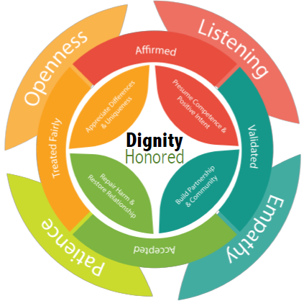
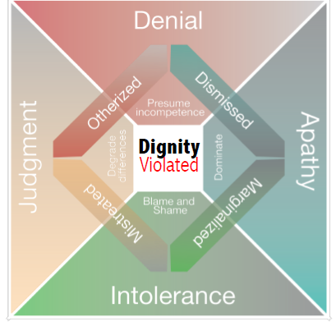
Notes:
Dignity is the foundation - the only foundation – upon which to build schools that work for every student.
When we show up everyday OPEN, LISTENING, SHOWING EMPATHY AND PATIENCE,
Then students feel AFFIRMED, VALIDATED, ACCEPTED AND TREATED FAIRLY.
In action, this looks like:
BUILDING PARTNERSHIPS AND COMMUNITY
REPAIRING HARM AND RESTORE RELATIONSHIPS
AFFIRMING DIFFERENCES AND UNIQUENESS
PRESUMING COMPETENCE AND POSITIVE INTENT
What hinders our ability to see and honor dignity are:
The distortions of JUDGEMENT, DENIAL, APATHY, INTOLERANCE
The indicators of Othering: otherized, mistreated, dismissed, marginalized
These violate dignity because they DEGRADE DIFFERENCES, PRESUME INCOMPETENCE, BLAME AND SHAME, OR DOMINATE
The good news: honoring dignity is free. It’s a culture shift. Circling back to the beginning: the culture is the strategy.

