Slide 1
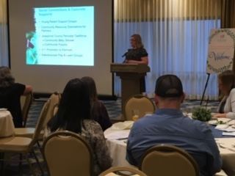
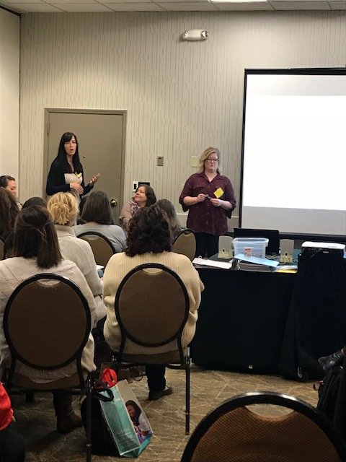
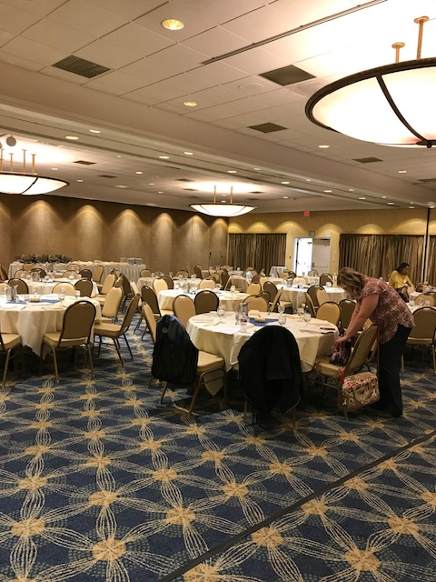
Chelsea is moving back to Florida!
Thank you for all of your creativity, enthusiasm, and get it done attitude!
Southern Oregon
will miss you!

Slide 2
SOELS Biennium in Review
GOALS
Coordinated, Aligned, Family-Centered System
Healthy, Stable, Attached Families
Children Prepared and Supported for Success in Kindergarten
2019-2021

Slide 3
SOELS Committee Work
Agency Advisory Council
Strategic planning using Raise Up Oregon to identify what our region is currently doing in support of the state’s strategies and what else we can and should be doing to support those strategies
Child & Family Wellbeing Committee
Survey of families regarding how/if they engage in services to learn what strategies might be effective for outreach
Promotion of Family Engagement Toolkit
Developing video library of parenting and child development topics to promote to partners
Early Learning Educational Equity Committee
Regional planning with partners around ELD Equity Fund Applications
Shared reading of Belonging through a Culture of Dignity: The Keys to Successful Equity Implementation and discussions of how to bring this content to our region within our spheres of influence
Creation of Shared Vision Statement for moving work forward

Slide 4
SOELS Committee Work, Cont.
Early Care & Education Workforce Committee
Emergency Child Care Communication - One Pager created for regional workforce and other sector partners; how families can access child care, definitions of essential workers
Aide II Legislation Letter – requesting temporary modifications to licensing requirements to allow flexibility for staff breaks, ratios due to workforce shortage
Early Learning Educator Survey - 26 responses from child care centers. Results highlighted the broad range of salary for lead teachers, staffing concerns as well as benefits offered to teachers
Family Needs Child Care Survey - 229 responses from both Jackson and Josephine families. Results highlighted the need for child care, provided employment and income information as well as the impact of COVID-19

Slide 5
Preschool Promise Coordinated Enrollment
First year complete, gearing up for summer and fall!
COVID left vacancies this year. Hopeful programs will be operating at full capacity in the fall.
280 Openings (Head Start has additional 54 PSP slots)
46 Vacancies
84% - One of the highest placement rates in the state
Regional Stewardship Committee/Coordinated Enrollment Workgroup used regional data analysis to promote targeted outreach to priority populations and identify better ways to reach families
Creating collaborative preschool flyer to promote PSP, Southern Oregon Head Start and OCDC preschool opportunities
Identified need for more support to families with children with disabilities, families living in rural communities and Spanish speaking families

Slide 6
Community Outreach and Engagement
Screening of the documentary “Foster” and presentation from Ashley Rhodes-Courter to community partners including DHS, CASA, early learning programs and social services organizations. The documentary highlighted the child welfare system is L.A county. There were 104 in attendance. $2,000
Screening of the documentary “No Small Matter” in partnership with the Children’s Institute to community partners including DHS, early learning programs and community organizations highlighting the child care crisis in the country. There were 88 in attendance. $350
Screening of “In Utero” and promoting local resources, our first virtual screening, partners came together to watch the documentary discussing life in the womb and its lasting impact on human development and behavior. There were over 200 in attendance. $500
Raising Resilience Campaign in partnership with AllCare and KOBI focusing on the importance of family resilience using different media platforms to reach families to emphasize the importance of connection and family stability. $22,000
Community Resource Orientations both in-person and virtual presentations focused on local community resources and services available in Jackson and Josephine counties. Presentations included the following topics: mental health, children’s, recovery/addiction, medical and social services. There were a total of 5 in person and so far three virtual presentations, presenting to over 400 participants. $100

Slide 7
Building Up the Early Care & Education Workforce
Paid internship opportunities for up to 10 Central Medford Students from general education, special education and transition classrooms. Internships are in child care centers. A navigator is provided to assist with recruitment, program application, training and site interview. $75,064
ECE Incentive Grant - Grant opportunity available to child care centers that serve one or more of our priority populations enabling programs to recruit and retain more teachers. 8 programs awarded 35 teacher incentive grants. $52,500
Early Childhood Enhancement Project (ECEP) cohort for early learning educators to receive coaching, community of practice and college course focused on social emotional child development. Served 32 teachers in Jackson and Josephine counties. $12,135

Slide 8
Building Up Child Care Access
Infant and Toddler Child Care Slots - 5 child care providers partnered with the Hub to offer free child care to families with infants and toddlers for 5 months. Children participating received developmental screening and referrals for additional services, if needed. Programs were also able to purchase developmentally appropriate materials, equipment and furniture for their infant/toddler classrooms. 24 children are being served. $102,500
Williams Community Preschool - Provides free or low cost preschool, 4 hrs/day, 4 days a week. Three Rivers school District has provided space within the Williams Elementary School. Preschool teacher works closely with the Kindergarten teacher to align curriculum to best support the transition into kindergarten. 20 children (with a waitlist). Additional afternoon focus program for children transitioning into Kindergarten in the fall. $94,140
Summer Preschool Programming Opportunities - Grant opportunity offered to programs to provide summer kindergarten readiness programming for children who will be entering kindergarten in the fall. 8 programs awarded. 84 children to be served. $198,348

Slide 9
Early Learning to Kindergarten Alignment
Early Learning and Kindergarten teacher PLT’s: focused on bridging the gap between early learning and kindergarten teachers. Provided shared learning opportunities and how to best serve the children and families transitioning into kindergarten. Used the EL/K guidelines as our guide. Provided classroom materials to participants. 21 Elementary schools. 16 Early Learning programs. $75,000
SORS Early Learning to Kindergarten Transition Summits: engaging families, early learning and kindergarten teachers in reaching share definition of ‘ready for kindergarten’; creating a universal student transition form to be passed from early learning to kindergarten; and improving family engagement $7,300

Slide 10
Family Stability Initiatives
Fire Relief Fund support to families impacted by the wildfires of 2020. 10 partner agencies. 335 families. $211,000
Strengthening Families Protective Factors Framework Training 160 participants; $1,700
Family Engagement Toolkit highlights 5 protective factors and what agencies can do to promote them with families. Distributed to over 400 partners.
Contribution to Family Nurturing Center’s Family Needs Screener for COVID and Fires for over 3,000 families & Respite Care support $154,000
Socially Distanced Play & Learn Groups for Isolated Families Facilitated play and learn group activities offered in a socially distanced environment focused on peer support and child development. $60,850

Slide 11
Foster Care System
Foster Care System Workgroup developed Summer Activities and Camp list for 2020 and 2021 as well as a foster parent resource page. The group meets to create alignment with initiatives and communication with partners that support foster families including Every Child, DHS, Foster Parent Associations, and CASA.
Every Child Josephine County - provided food/snacks for families during visits, spring break family kits, resources including beds, car seats and basic necessities to foster families, as needed. $5000
Jackson County Foster Parent Association - provided equipment and storage for the warehouse as well as incentives for families volunteering in the clothing warehouse. DHS Child Welfare received Target gift cards to provide to foster families to meet emerging needs for new placements, foster parent retention and training participation. $8000

Slide 12
Families in Recovery
Choices/Options for Southern Oregon - funding to create a welcoming, trauma informed and supportive environment for participants to feel comfortable seeking assistance with job searches, virtual counseling and peer support $18,800
OnTrack Rogue Valley - funding a mental health professional to support the Dad’s program to support with self-sufficiency and graduating from the program $31,614
Oasis Center of the Rogue Valley - funding new equipment for pediatric services; salary costs for their Children’s Services Manager as well as developmentally appropriate supplies for the family playroom; parenting education materials and take-home supplies for parents $22,000

Slide 13
Teen Parent Support
Jackson County Teen Parent Advisory Council & Josephine County Teen Parent Partner Workgroup – two networks of school district and community partners to identify strategies to support teen parents. $25,000
Incentives for education and life skills accomplishments during COVID
Josephine County Young Mom’s Group – provides weekly engagement remotely and socially distanced in person connection to young mom’s and their children. 15 teens. $20,000
Education on topics relevant to young parents, connection to community partners, safe space
Incentives for education and life skills accomplishments during COVID

Slide 14
Impact of Systems Alignment Efforts
EI/ECSE + MH Partnership identifies opportunities to improve the early intervention and behavioral health referrals and resources so that families with young children who experience disabilities and/or behavioral health needs are engaged in services that will support and strengthen them.
Home Visiting Network & MIECHV opportunities to create support systems for home visitors through professional development and resources. The network and leadership team meets once a month. The attendance for the network varies from 10 to 40 participants depending on the topic. $1000
Supporting PSP programs to be able to serve children with disabilities through a collaboration of early learning and disability partners to create shared learning, identify needs and processes for supporting families and programs to better serve children with disabilities

Slide 15
Other Partner Collaborations
Regional Community Health Assessment and CHIP Families Matter planning participated in the family support goal focusing on services to support family stability. The Hub submitted an objective in regards to the Strengthening Families Training.
City of Medford subcommittee on child care grant participated in the advisory and review committee to determine how the city of Medford could use city dollars for child care scholarships. The city contracted with two early learning programs to offer free child care to families in Medford.
SORS Design Team, Workgroups and Network Convenings
Family Stability- developed a Family Advisory Council to serve the region as a parent voice driver in the community.
Early Childhood Supports- is promoting UP Together to support social connections and goal setting for families through the use of an online platform to track growth and provide incentives for participation.
Early Learning & K Transition Workgroups
SOREN is a collaborative workgroup focused on professional development supports for K-12 with a focus on inclusion and equity, implementation of positive discipline and district alignment.

Slide 16
Other Partner Collaborations
Josephine Co Perinatal Taskforce: focused on families during the prenatal to toddler period and identifies focus areas such as breastfeeding and behavioral health.
Healthy Families Advisory: focused on sharing the work of the healthy families program in both Jackson and Josephine counties sharing data about family stability and needs as well as the benefits of home visiting services.
Jackson Care Connect (CAC) is focused on incorporating Jackson Care Connect members voice in the implementation of services through JCC as well as provide updates and resources to benefit community partners and families in Jackson County.
Early Childhood Advisory Committee: Head Start and Early Head Start committee focused on how to best support families transitioning from HS into the K-12 system. Working with districts on better alignment with assigned SSDI numbers to track children's early learning experiences and into the K-12 system.
SOESD Curriculum Directors Meeting: Participate in monthly meetings to hear and understand where and how the Hub can better support districts and elementary schools with family engagement, kindergarten transition and professional development.

Slide 17
Other Partner Collaborations
Southern Oregon Chapter of the Education of Young Children is focused on supporting early learning educators and programs by providing professional development opportunities including the winter conference and increase chapter membership in Southern Oregon. $7,750
The Family Connection Advisory - offering feedback on TFC’s planning and implementation of parenting education in the region. Supported programming. $ 7,100
Infant/Toddler Cohort Planning participated in the planning of the Infant/Toddler cohort model offered through Child Care Resource Network. The goal was to increase supports available to infant/toddler educators by providing coaching and training.

Slide 18
Looking to 2021-2023
JULY Meeting
Review current investments and regional needs and determine what to continue to invest/support
Cassie Bruske/Eames Consulting gives Legislative Wrap Up
Lisa O’Connor’s last GC meeting. Recruit for Family Education & Support Representative
NO MEETING IN AUGUST
SEPTEMBER Meeting
Finalize Budget and Investment Priorities at September Meeting
Recruit new participants to workgroups

